Slide 1
Sprint 1: Flu Vaccination Predictor Project
By ALPHA GROUP
Assimagbe Albert Raphael & Saad Ali
📊 Based on CDC H1N1 2009 Survey Data

Slide 2
Project Goals & Questions
Objectives:
- Identify who gets flu vaccines and why
- Understand role of doctor recommendations
- Use machine learning to predict vaccine behavior
- Suggest smart ways to improve vaccination
Key Questions:
- Who avoids the vaccine?
- Do doctor suggestions help?
- Which behaviors matter most?

Slide 3
Dataset Summary
Source: CDC 2009 H1N1 Survey
Size: 26,707 people, 36 features
Data Includes:
- Demographics (age, education, race, gender, etc.)
- Behaviors (handwashing, avoidance)
- Health opinions and access
Challenge: Missing data in some columns (up to 50%)

Slide 4
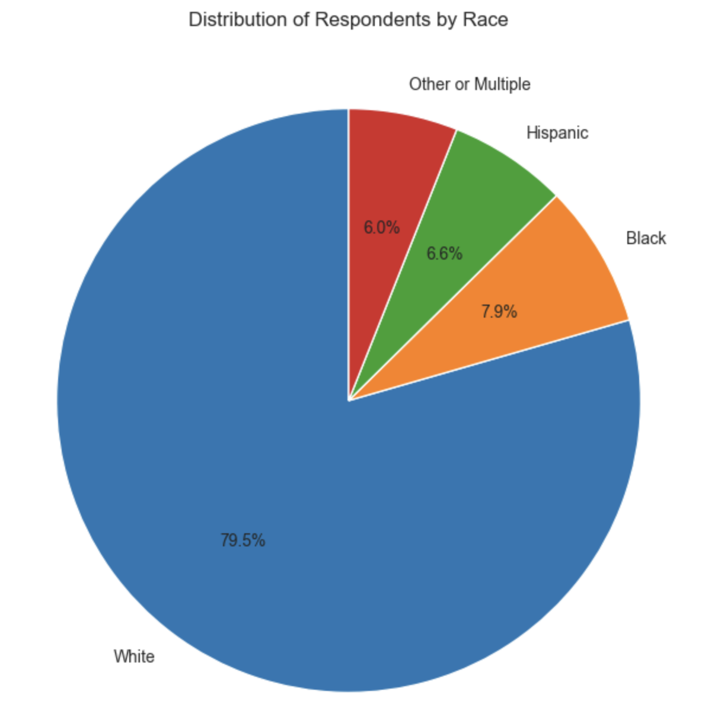
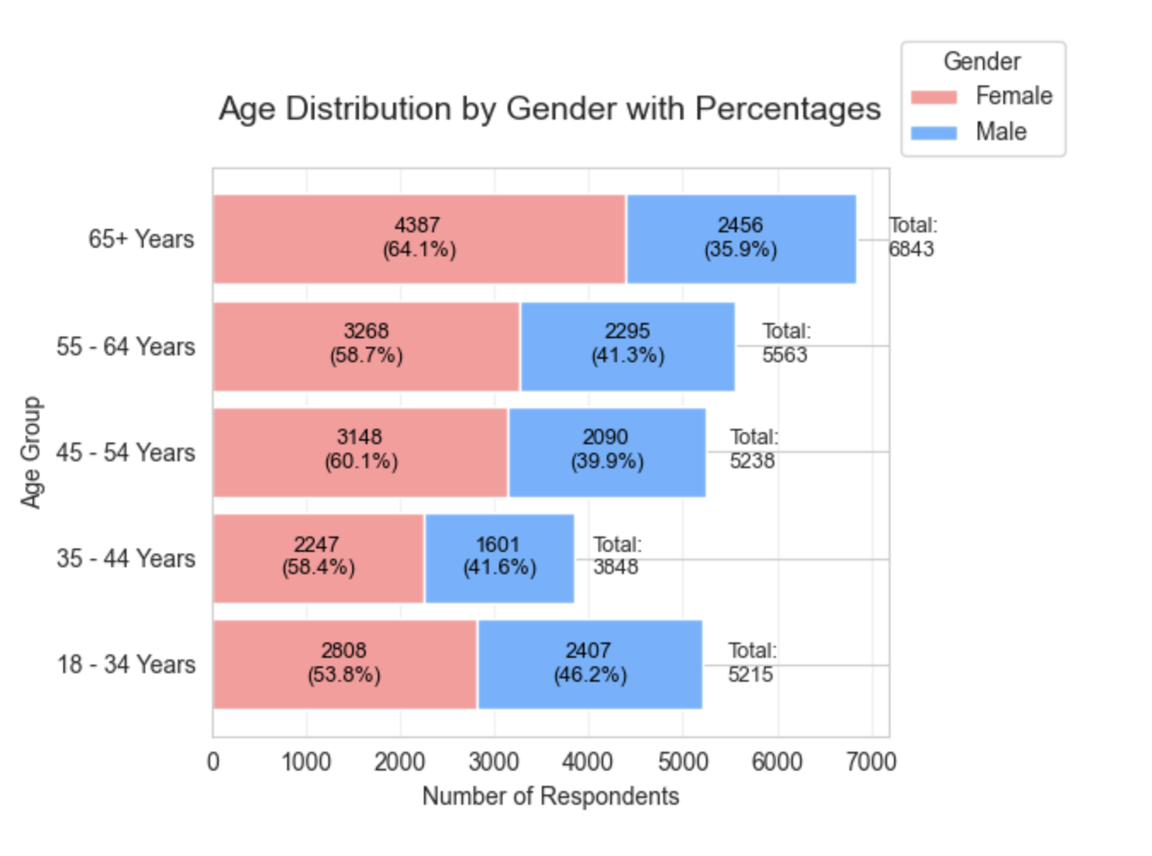
Visuals Of Race & Age Distributions

Slide 5
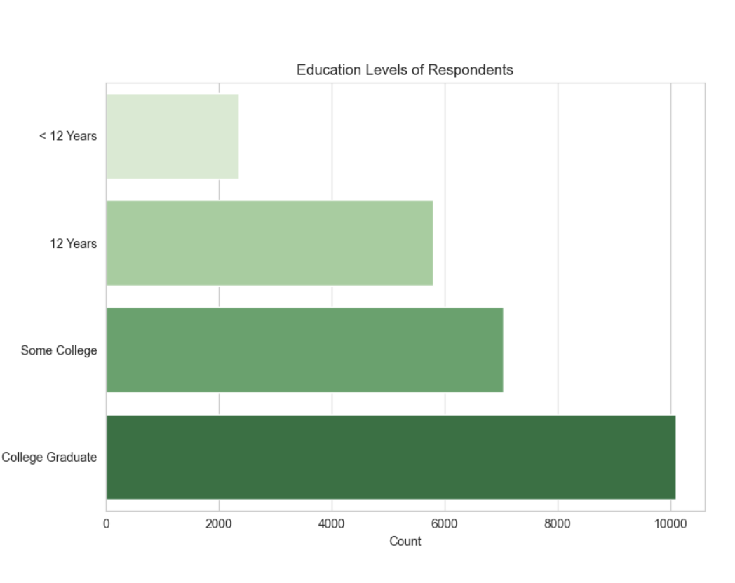
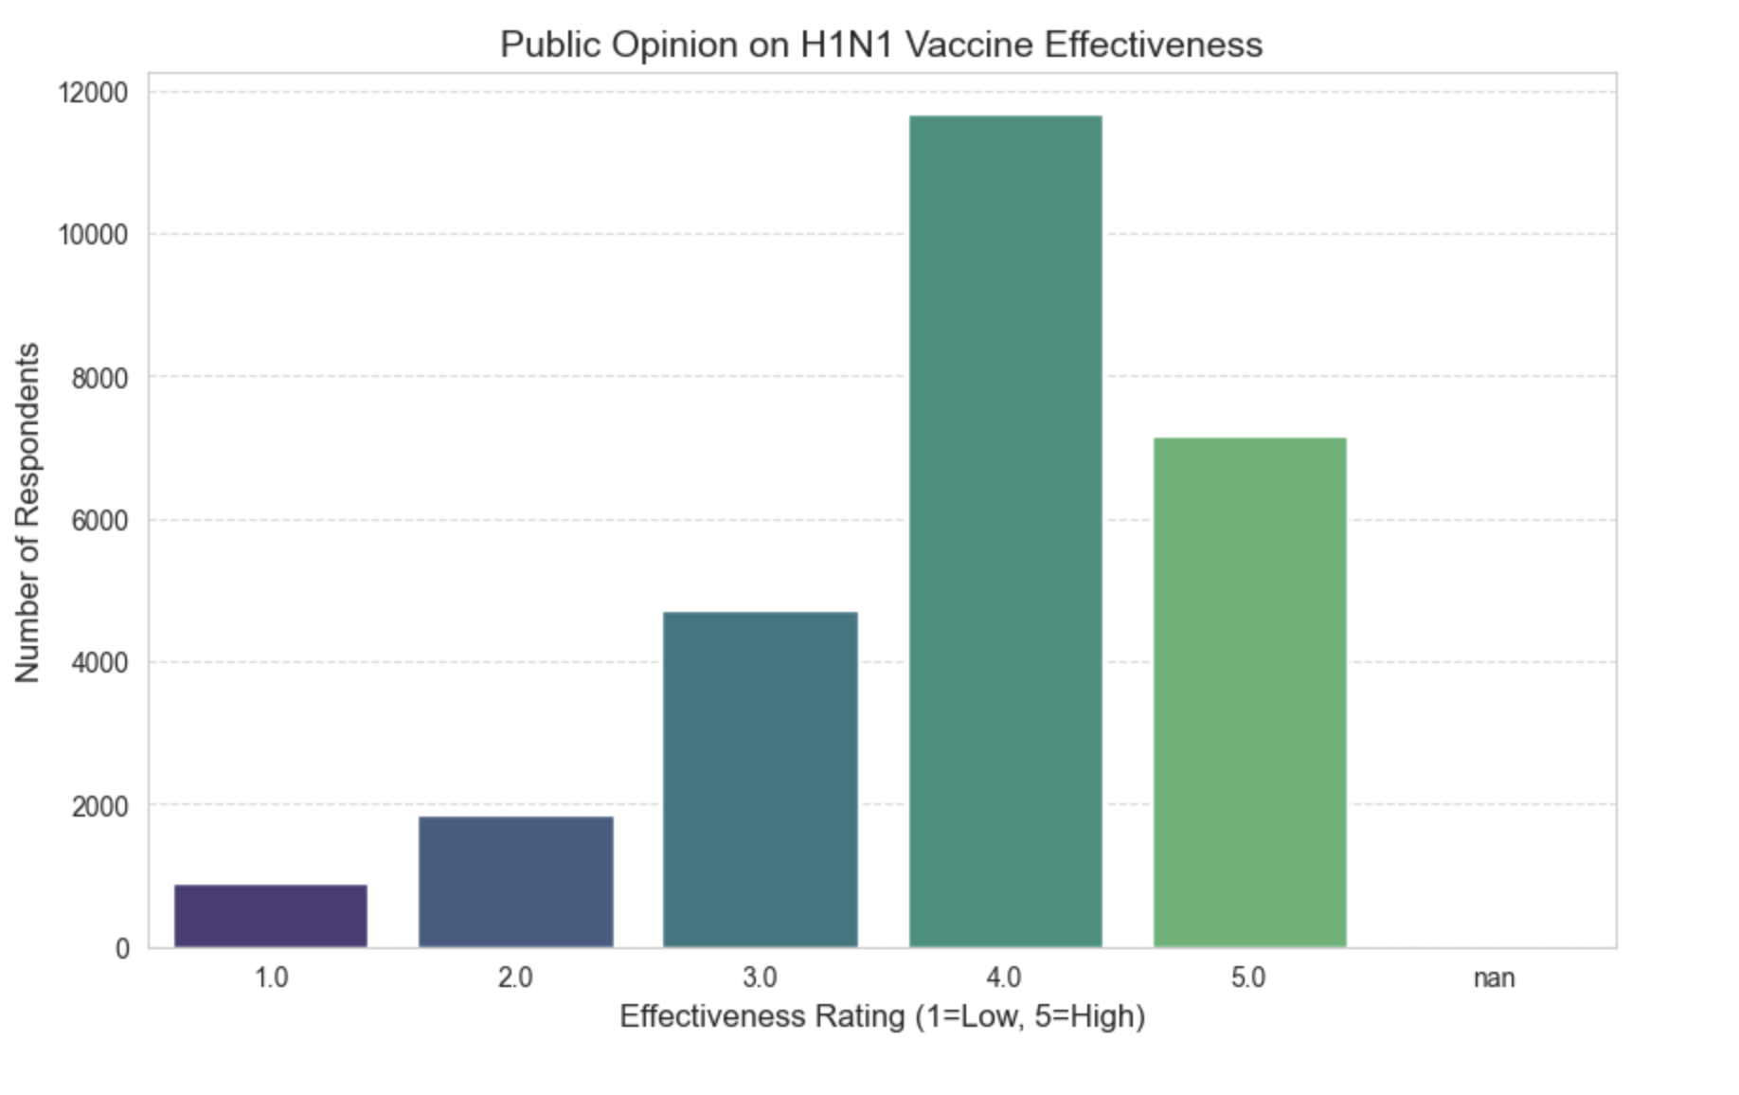
Visuals Of Educational Levels & Public Opinion

Slide 6
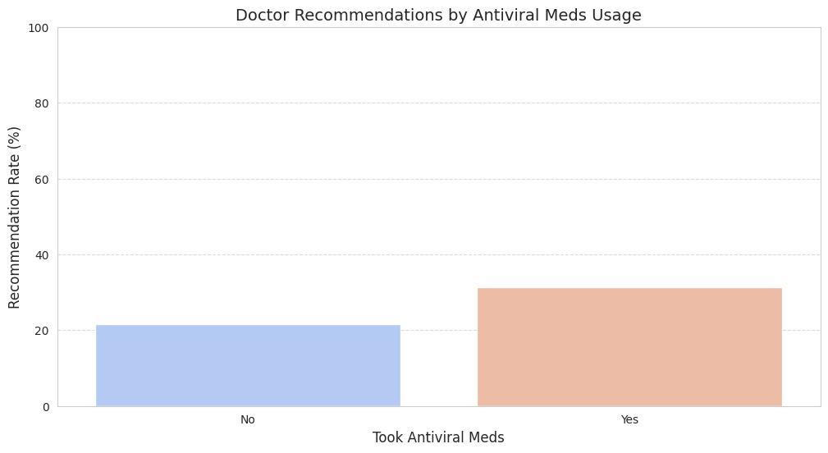
Key Findings & Visuals
1. Doctor Recommendations Influence Vaccination

Slide 7
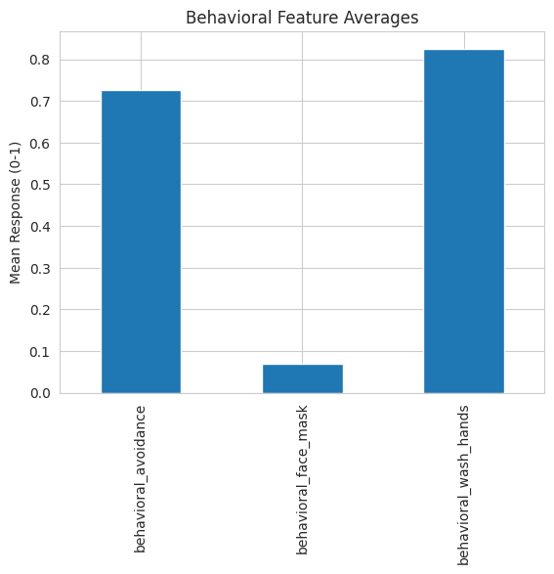
Key Of Findings
2. Concern about H1N1 Virus = more handwashing

Slide 8
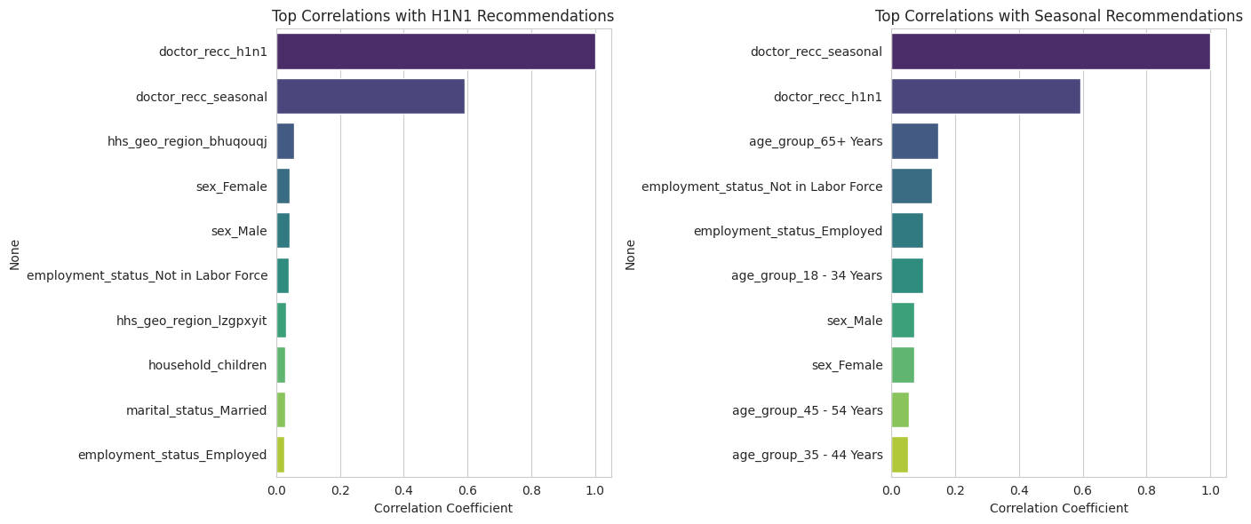
Key Findings & Visuals
3. Older adults (65+) more likely to get seasonal flu shots

Slide 9
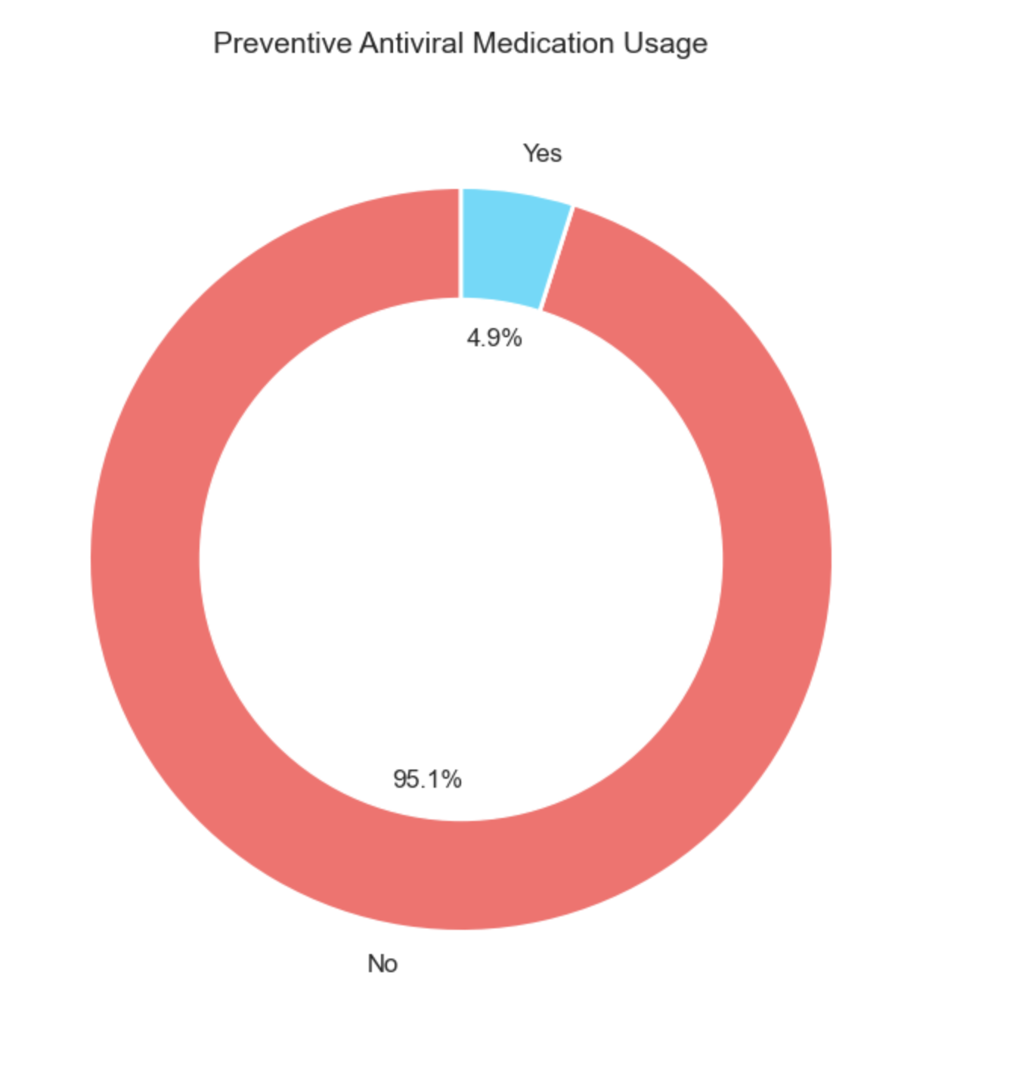
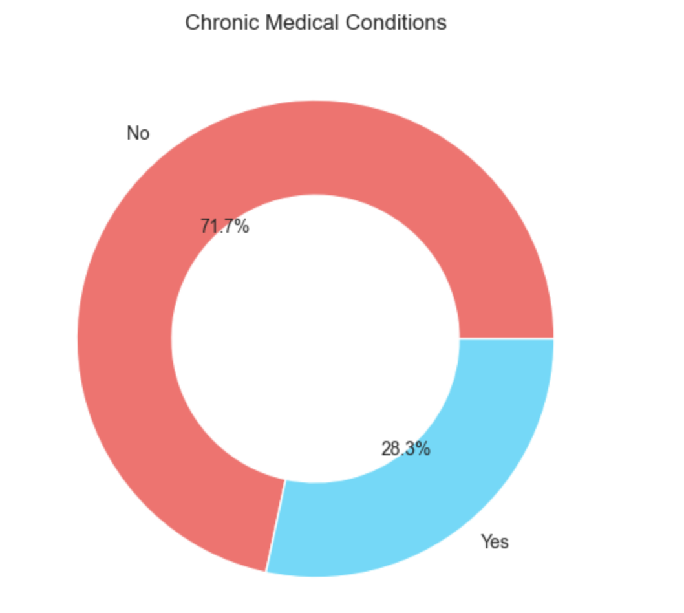
Key Findings & Visuals
3. Older adults (65+) more likely to get seasonal flu shots
4. 4.9% Persons takes Preventive Antiviral Medication while, 28.3% Persons has chronic medical conditions

Slide 10
Data Analysis Summary
Cleaned all missing data:
-Dropped high-missing columns (employment_occupation (50 %), employment_industry (49.9%), health_insurance (45.9%), etc.)
Important Analysis:
- Doctor recommendation (47.5%)
- H1N1 Virus concern – face mark, wash hand and avoidance (57.2%)
- Vaccine effectiveness belief
- Preventive Antiviral Medical Usage (4.9%)
- Chronic conditions (28.3%)

Slide 11
Recommendations
1. Train doctors to give strong, clear vaccine advice
2. Target under-vaccinated groups (50–64 year-olds)
3. Use SMS campaigns and infographics
4. Promote combined vaccine confidence messages
Final Thoughts
✅ Machine learning can help target interventions
✅ Beliefs and doctor input matter more than demographics
📢 Next step: Build prediction tool for clinics

